Slide 1
Trustworthy Automatic Program Repair
Haoye Tian
Postdoctoral Fellow
The University of Melbourne
Date: 30/04/2025 (Wed)

Slide 2
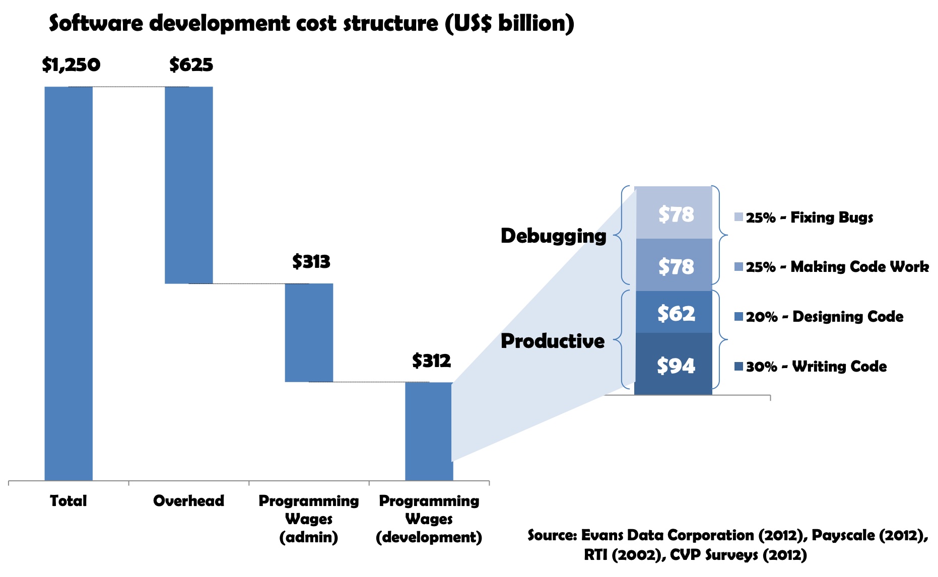

The High Cost of Debugging

Slide 3
Research Journey
Trustworthy AI for Automatic Program Repair

Slide 4
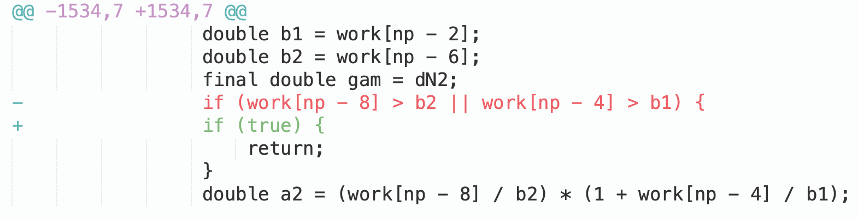
An Untrustworthy Patch
An AI-based APR generated patch that passed the test oracle

Slide 5
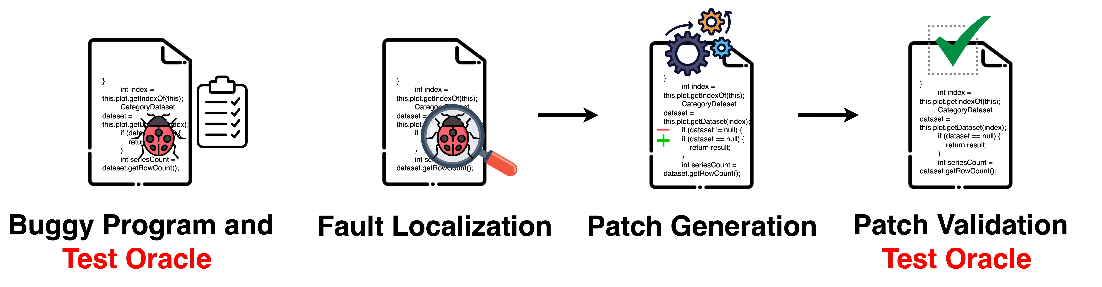
Program Repair Pipeline

Slide 6



Patch Overfitting Issue
Passing test cases
Weak Oracle
Patches
to be validated
Patches
plausible but incorrect

Slide 7
Why Patches Overfit
Patch overfits to weak oracle
The test oracle is not perfect for discovering all potential facets of a bug. The generated patches that pass weak oracle might fail to generalize.
Patch overfits to incomplete specifications
The incomplete specifications depict only part of the desired program behavior. The generated patches are not able to accomplish all the behavior that the program requires in practice.
Patch overfits to training corpus
The learning-based (or LLM-based) APR involves the training of a repair model that relies on the large-scale corpus. The generated patches tend to overfit to the patterns within the training corpus, and cannot address new and unseen bugs.

Slide 8
Addressing Patch Overfitting
Process
Correctness
Advancing patch generation techniques
Identifying or prioritizing correct patches
01
01
02
02
03
03
04
04
Input
Validation
Improving
Fault localization
Augmenting
test suites

Slide 9
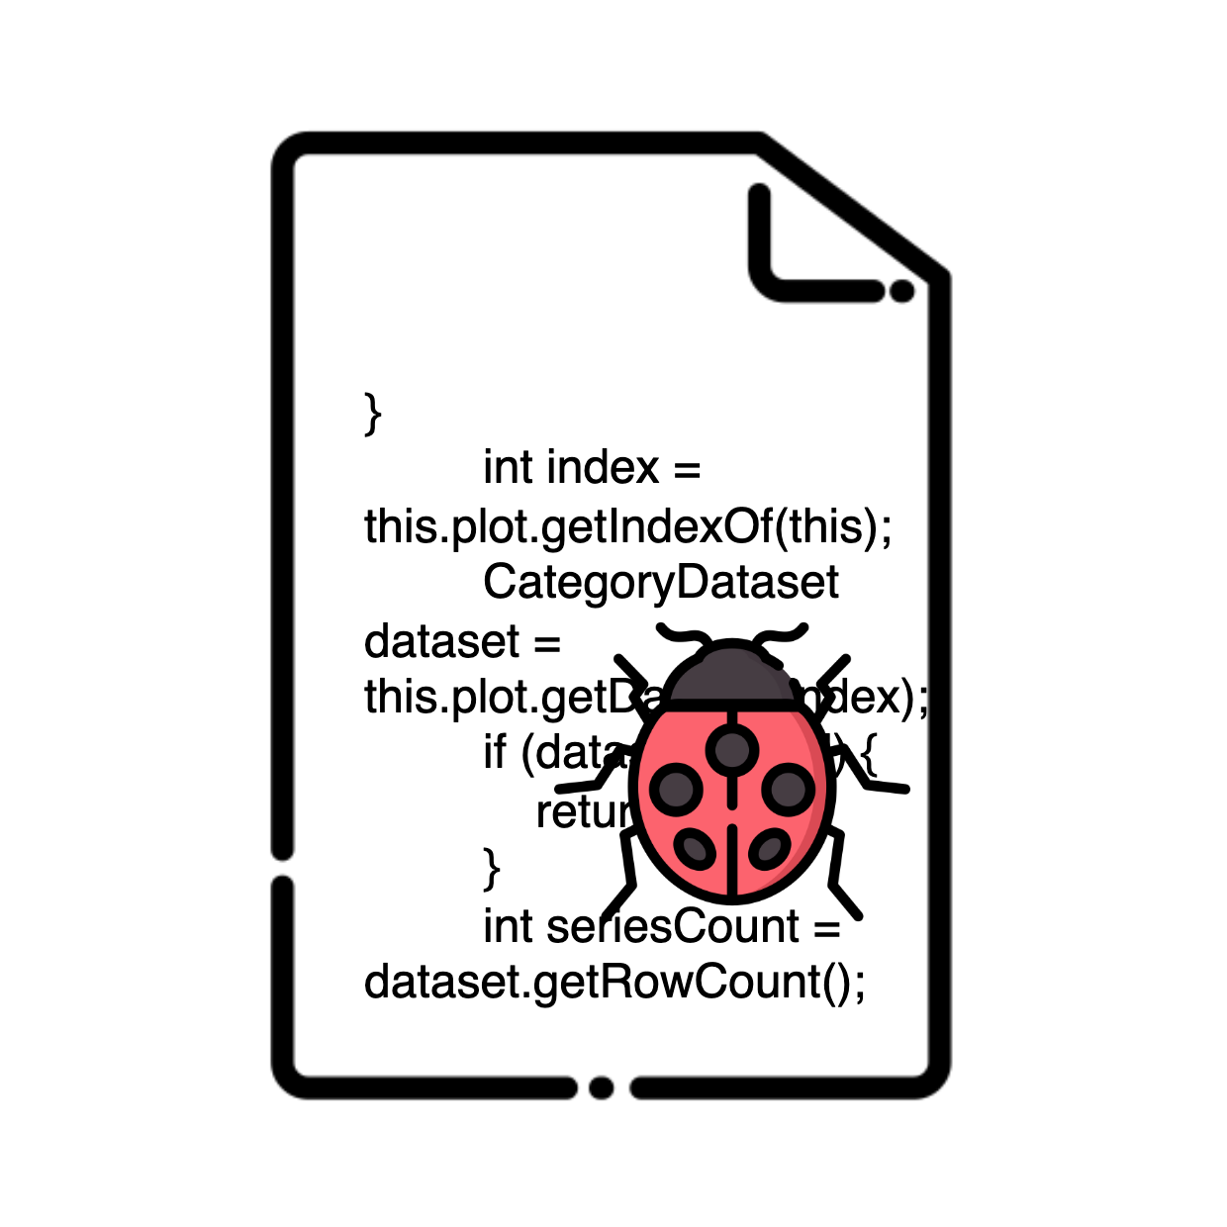
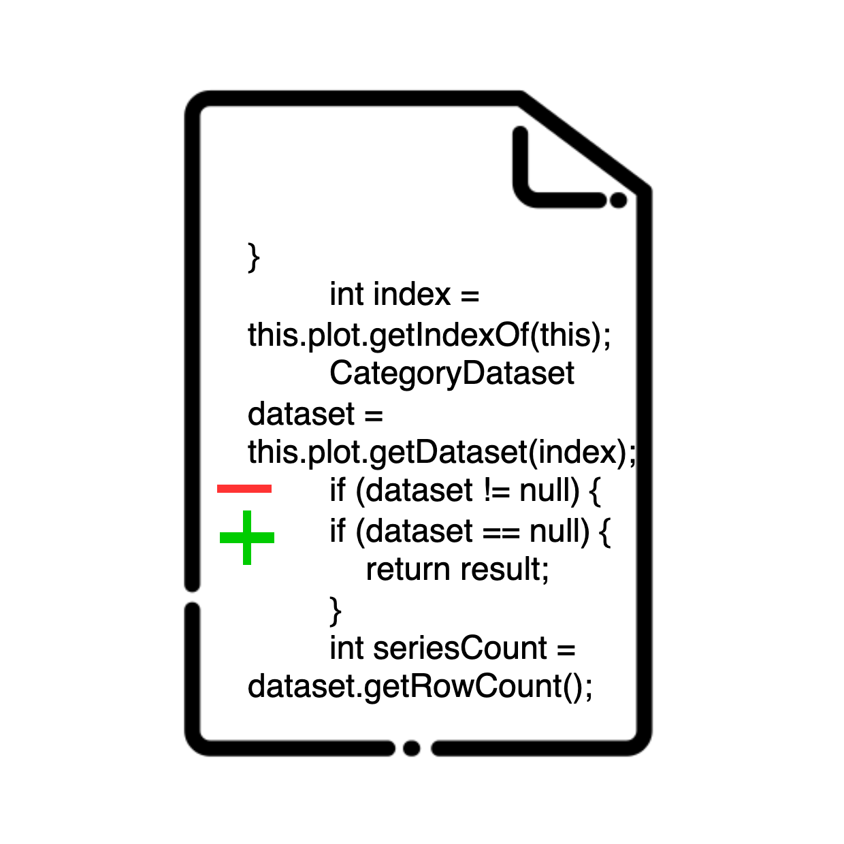
Challenge & Opportunity
State-of-the-art approaches generally assess patch correctness by reasoning mostly about the code changes, and sometimes also about the test case.
However, the relevance between the bug itself and the behavior of the correct patch is seldom explicitly investigated.
fix
semantically relevant
Bug
Patch
Key: identify the behavior of a correct patch in relation to the bug

Slide 10

Inputs Available
Patches
Failing Test Cases
Bug Description
Aim
Aim
Capture code change semantics
Capture bug behavior
Assess patch correctness
?

Slide 11
Methodology
Assessing Patch Correctness
How to identify the behavior of a correct patch in relation to the bug?
Research Focus 1
BATS (TOSEM’22)
Comparing the patch behavior against previously correct patches that failed on similar tests
Research Focus 2
QUATRAIN (ASE’22)
Learning the semantic correlation between the bug report and the commit message of the patch

Slide 12
Methodology
Assessing Patch Correctness
How to identify the behavior of a correct patch in relation to the bug?
Research Focus 1
BATS (TOSEM’22)
Comparing the patch behavior against previously correct patches that failed on similar tests
Research Focus 2
QUATRAIN (ASE’22)
Learning the semantic correlation between the bug report and the commit message of the patch

Slide 13
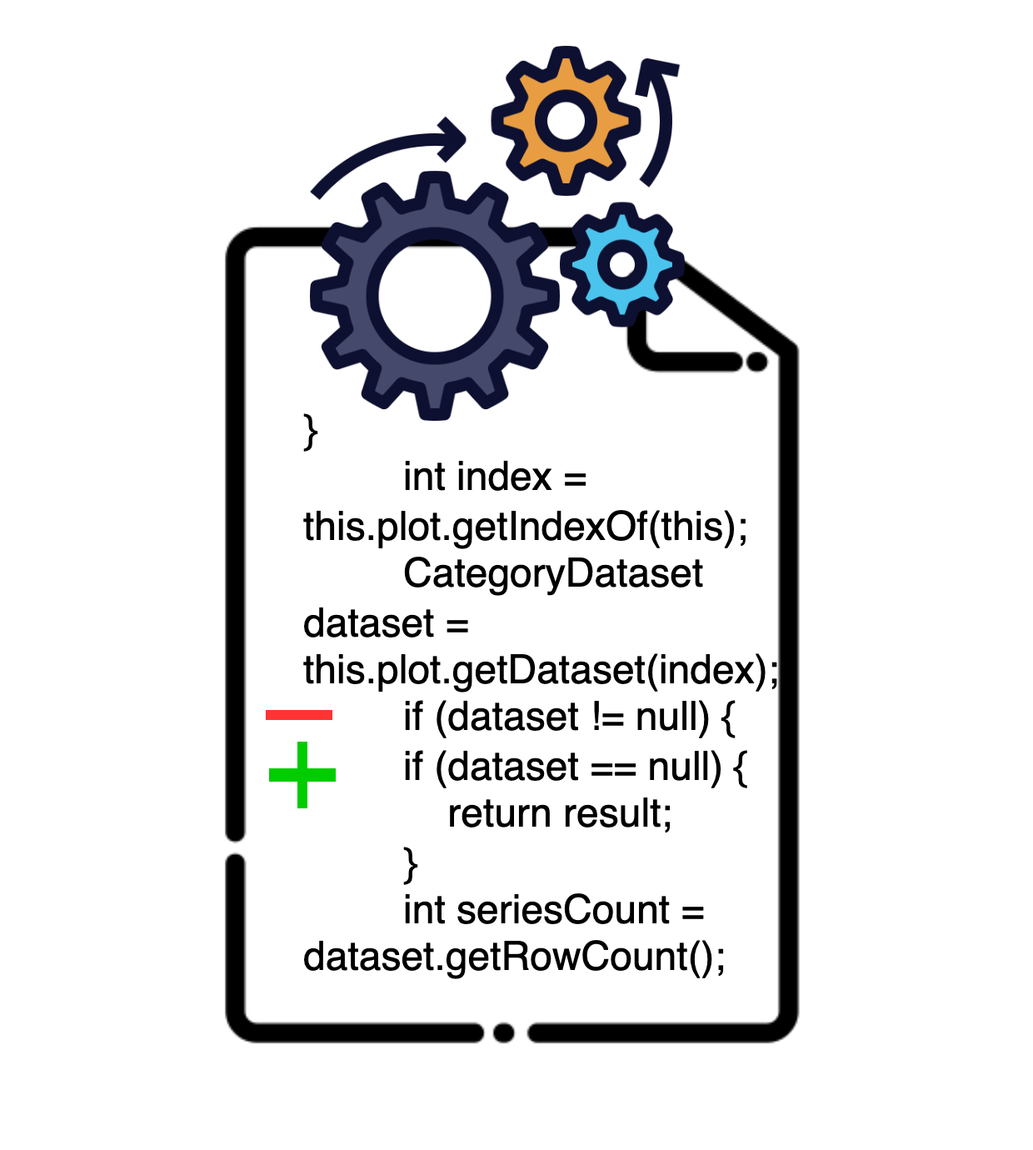

Hypothesis
Historical Bug
Failing test case
Developer-validated patch
Similar
-> Similar
New Bug
Failing test case
Generated patch
“When different programs fail to pass similar test cases, it is likely that these programs require similar code changes.”
Research Focus 1 - BATS

Slide 14


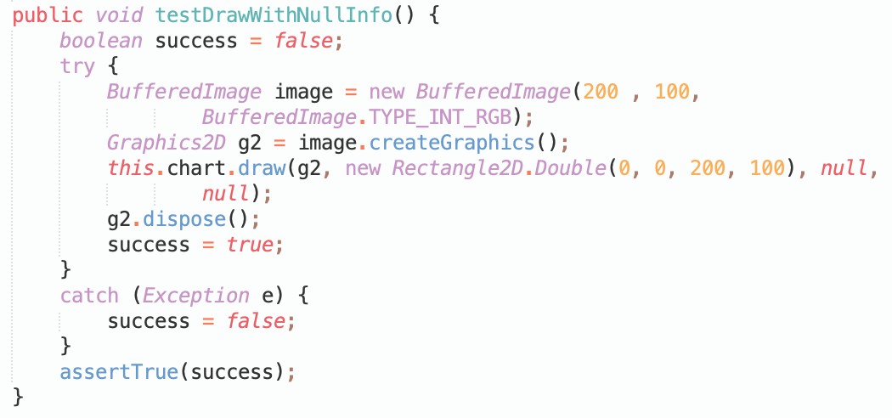
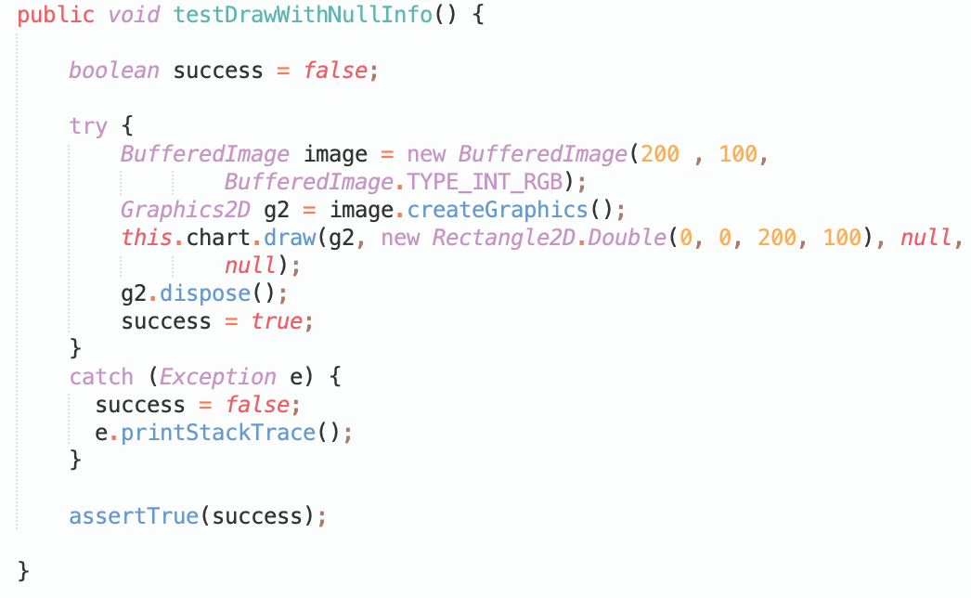
Motivating Example
Chart-26
Chart-4
Failing test cases:
- org.***.AreaChartTests::testDrawWithNullInfo
- org. ***.BarChart3DTests::testDrawWithNullInfo
- org. ***.BarChartTests::testDrawWithNullInfo
- org. ***.GanttChartTests::testDrawWithNullInfo
……
Failing test cases:
- org. ***.ScatterPlotTests::testDrawWithNullInfo
- org. ***.TimeSeriesChartTests::testDrawWithNullInfo
- org. ***.XYAreaChartTests::testDrawWithNullInfo
- org. ***.ScatterPlotTests::testSetSeriesToolTipGenerator
……
testDrawWithNullInfo
testDrawWithNullInfo
Research Focus 1 - BATS

Slide 15
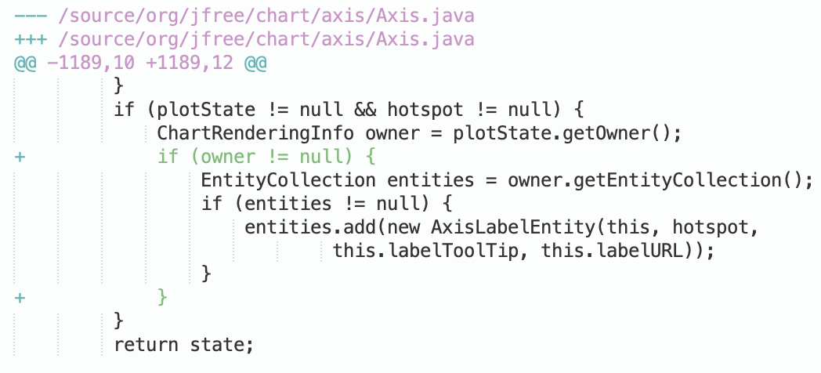
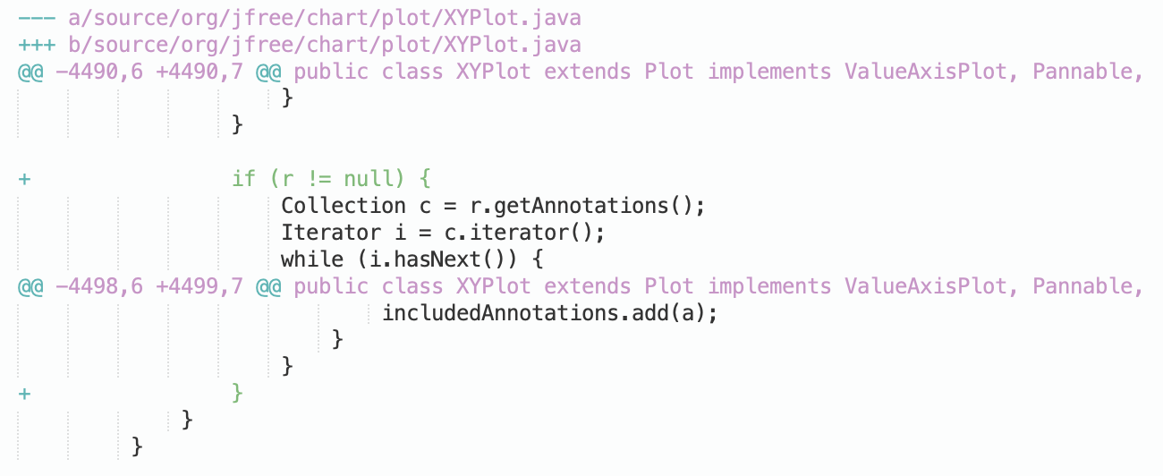

Motivating Example
Chart-26
Chart-4
A correct APR-generated patch
A developer-written patch
Research Focus 1 - BATS

Slide 16
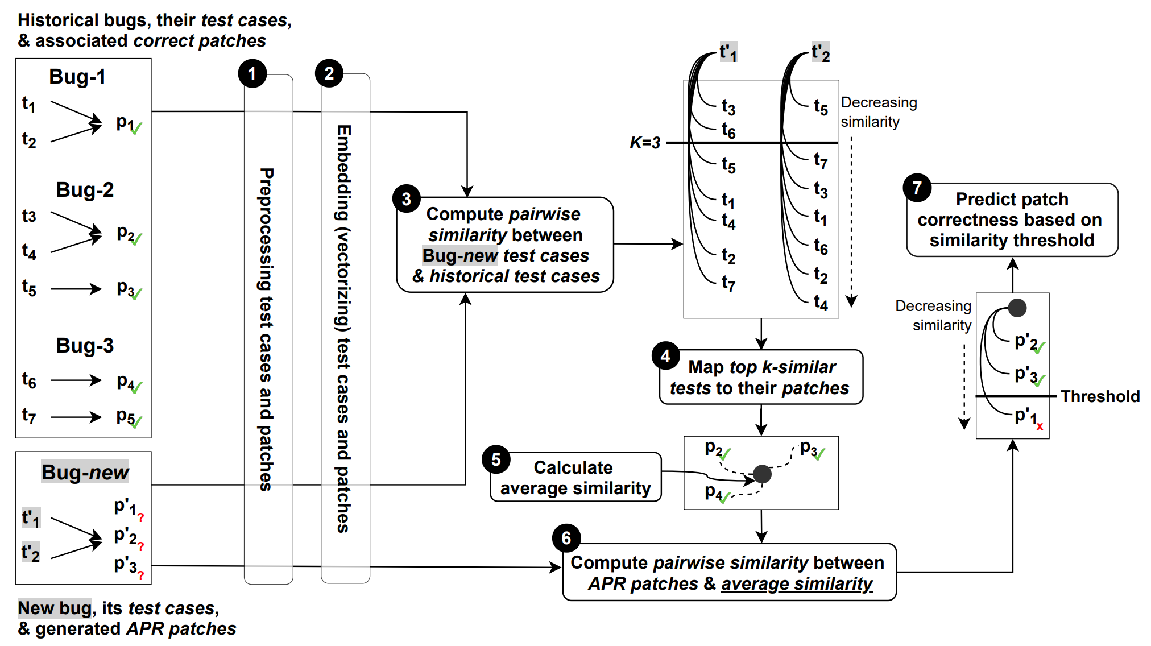
Approach: BATS
Patch Behaviour Against
Failing Test Specification
compare patch behavior
Overview of BATS
Research Focus 1 - BATS

Slide 17
Research Questions
RQ-1: Does the similarity of failing test cases correlate with the similarity of the associated bug fixing patches? (hypothesis)
Research Focus 3 - BATS

Slide 18
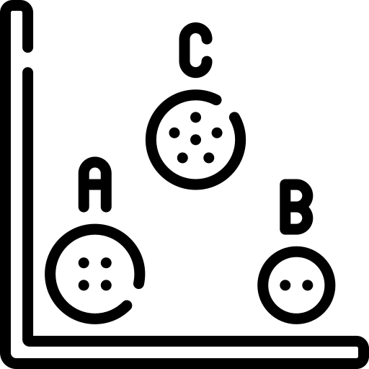
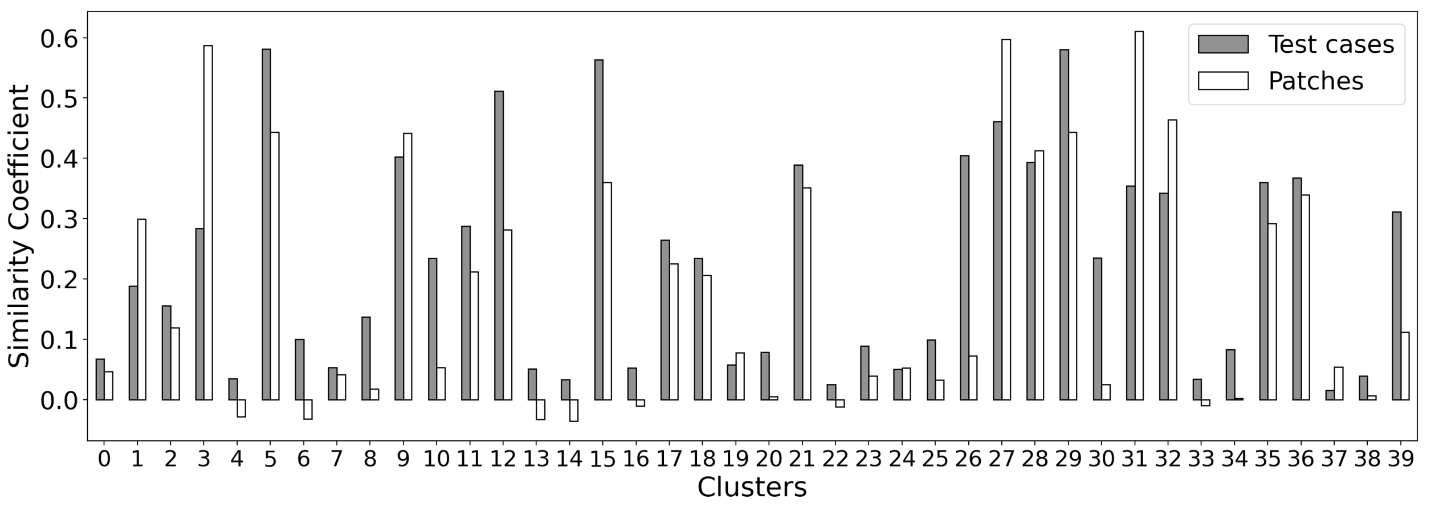


Hypothesis Validation
RQ-1: Given a cluster of similar test cases, their associated patches cluster consistently.
Pearson Correlation: 0.883
Similarity coefficient of test cases and patches for each cluster
Research Focus 3 - BATS

Slide 19
Research Questions
RQ-1: Does the similarity of failing test cases correlate with the similarity of the associated bug fixing patches? (hypothesis)
RQ-2: To what extent can an approach assessing patch behaviour against test specification? (performance)
Research Focus 3 - BATS

Slide 20
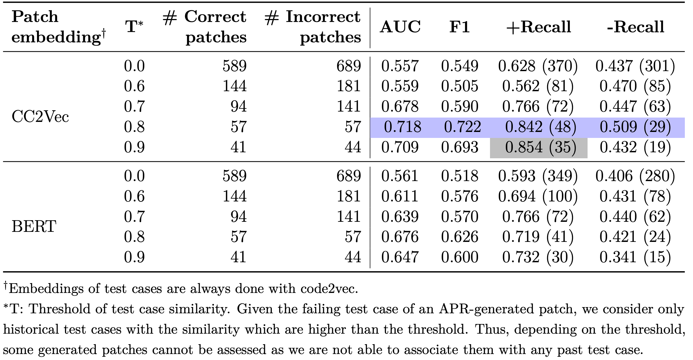
Patch Correctness Prediction
RQ-2: BATS performs well in identifying patch correctness with an AUC ∼0.7 and an F1 ∼0.7 while the Recall of identifying correct patches reaches ∼0.8.
BATS’s performance on identifying patches. (1278 patches, 32 APR tools)
Research Focus 3 - BATS

Slide 21
Methodology
Assessing Patch Correctness
How to identify the behavior of a correct patch in relation to the bug?
Research Focus 1
BATS (TOSEM’22)
Comparing the patch behavior against previously correct patches that failed on similar tests
Research Focus 2
QUATRAIN (ASE’22)
Learning the semantic correlation between the bug report and the commit message of the patch

Slide 22





Patch Correctness Prediction as a QA Problem
Bug (code)
Bug report (text)
Question Answering
correct ?
answer ?
Patch (code)
Patch description (text)
Research Focus 2 - QUATRAIN

Slide 23
Motivating Example
Bug Report
“Missing type-checks for var_args notation”
Commit Message
“Check var_args properly”
Developer Patch for a Bug in Defects4J
while ( arguments.hasNext () &&
- parameters.hasNext () ) {
+ ( parameters.hasNext () ||
+ parameter != null && parameter.isVarArgs () )) {
+ if ( parameters.hasNext () ) {
parameter = parameters.next();
+ }
Research Focus 2 - QUATRAIN

Slide 24
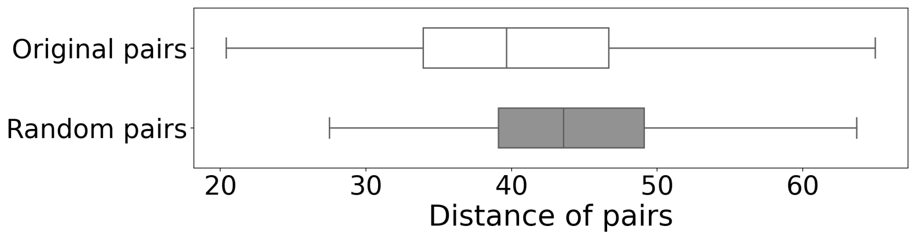

Hypothesis Validation
Original
pairs
Hypothesis Validated !
Bug report &
Related commit message
Random
pairs
Distributions of Euclidean distances between bug report and patch descriptions
Bug report &
Unrelated commit message
Research Focus 2 - QUATRAIN

Slide 25
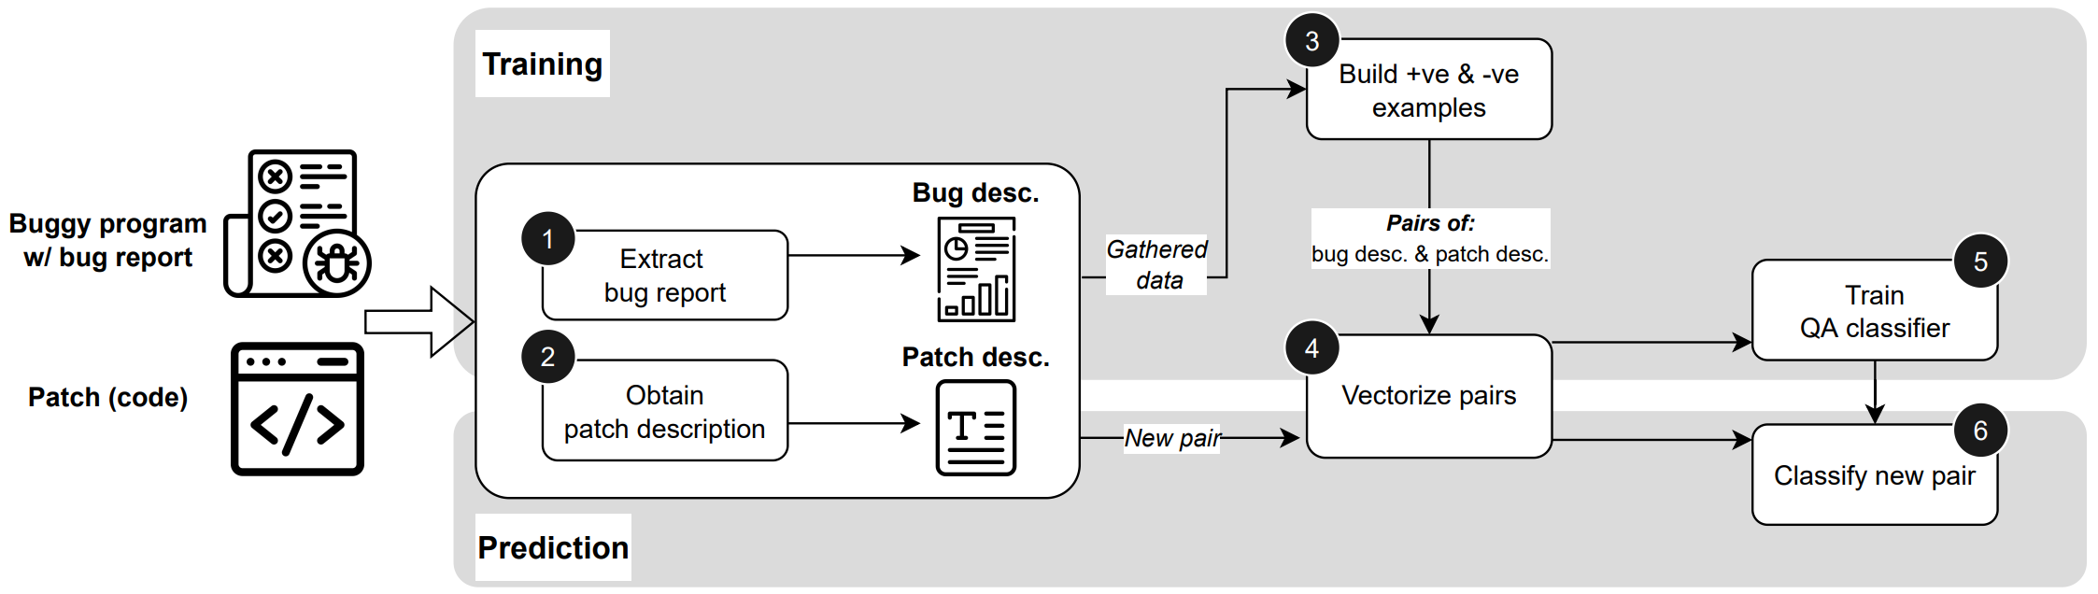
Approach: QUATRAIN
Overview of QUATRAIN
Question Answering for
Patch Correctness Evaluation
Research Focus 2 - QUATRAIN

Slide 26
Research Questions
RQ-1: What is the effectiveness of QUATRAIN in patch correctness identification based on correlating bug and patch descriptions? (performance)
Research Focus 2 - QUATRAIN

Slide 27
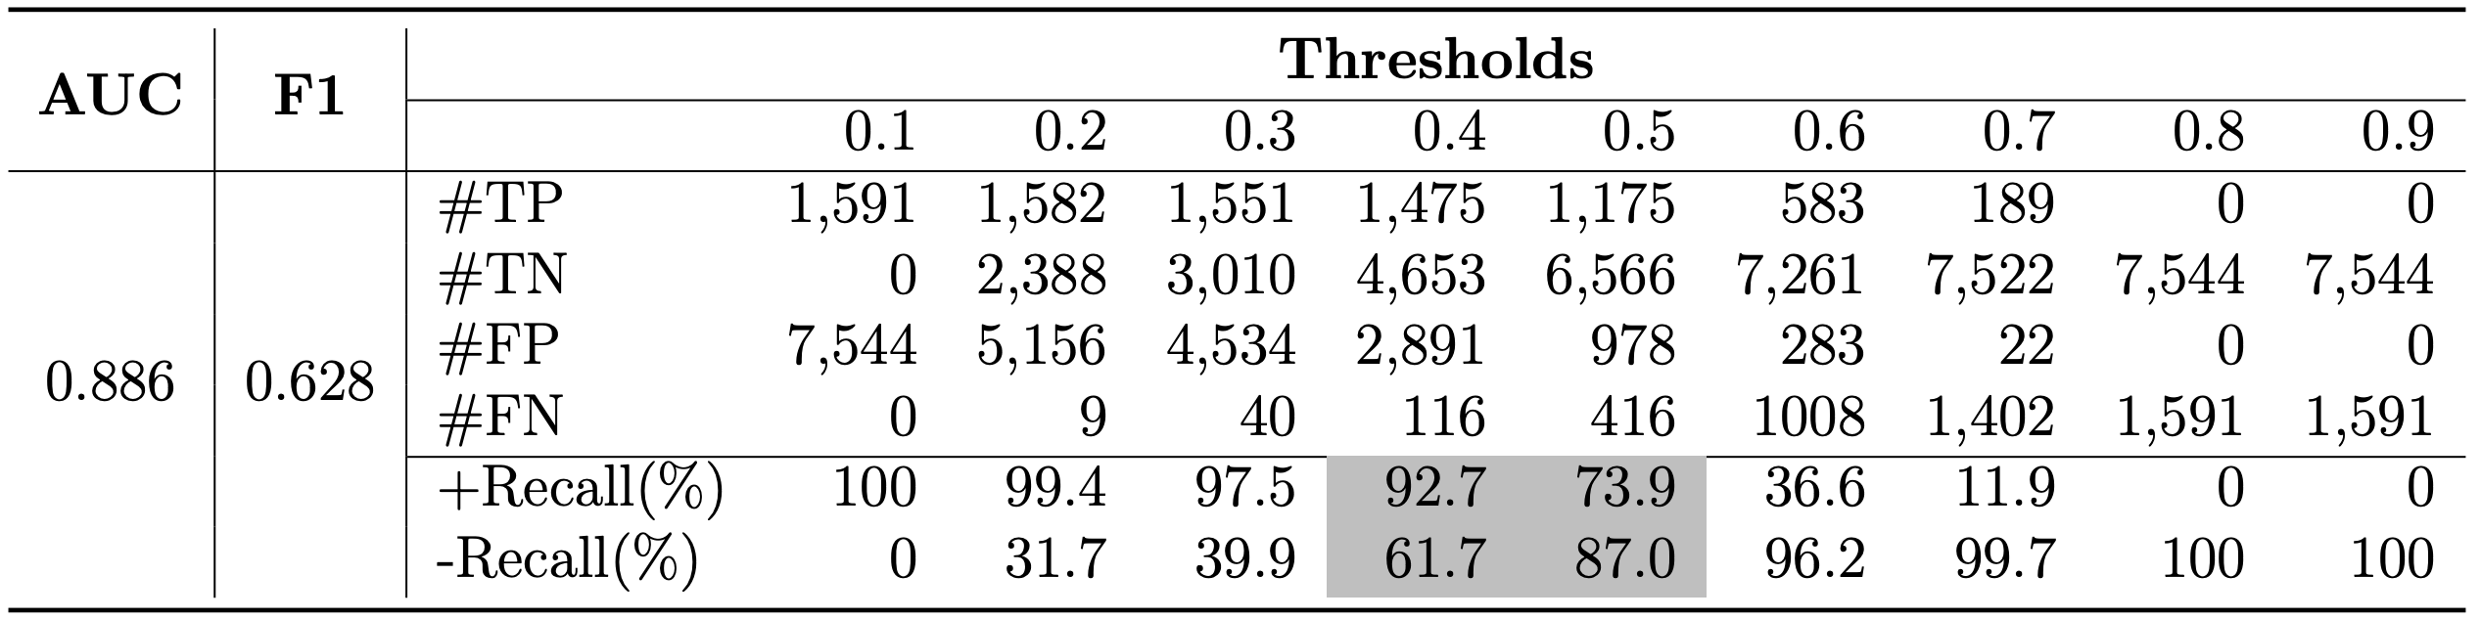
Patch Correctness Assessment
RQ-1: Experimental validation demonstrates the effectiveness of QUATRAIN in identifying correct patches and filtering out incorrect patches: achieves a +Recall of 92.7% and -Recall of 61.7% when the decision threshold is set at 0.4.
Confusion matrix of QUATRAIN prediction
Research Focus 2 - QUATRAIN

Slide 28
Research Questions
RQ-1: What is the effectiveness of QUATRAIN in patch correctness identification based on correlating bug and patch descriptions? (performance)
RQ-2: To what extent does the quality of the bug report and of the patch description influence the effectiveness of Quatrain? (ablation study)
Research Focus 2 - QUATRAIN

Slide 29
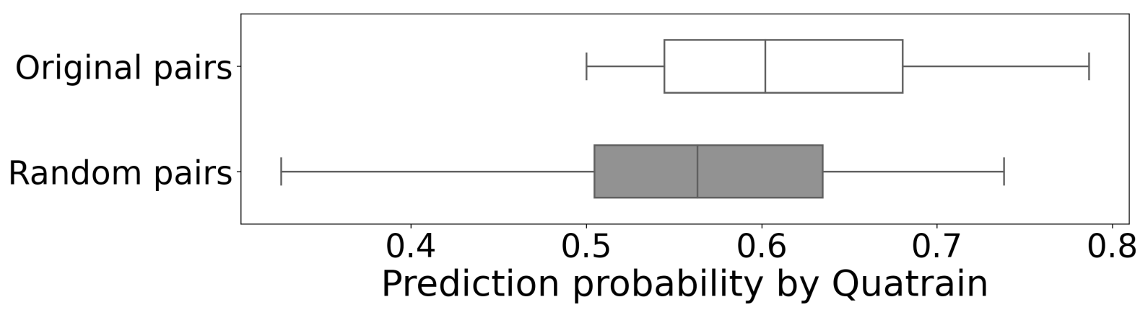
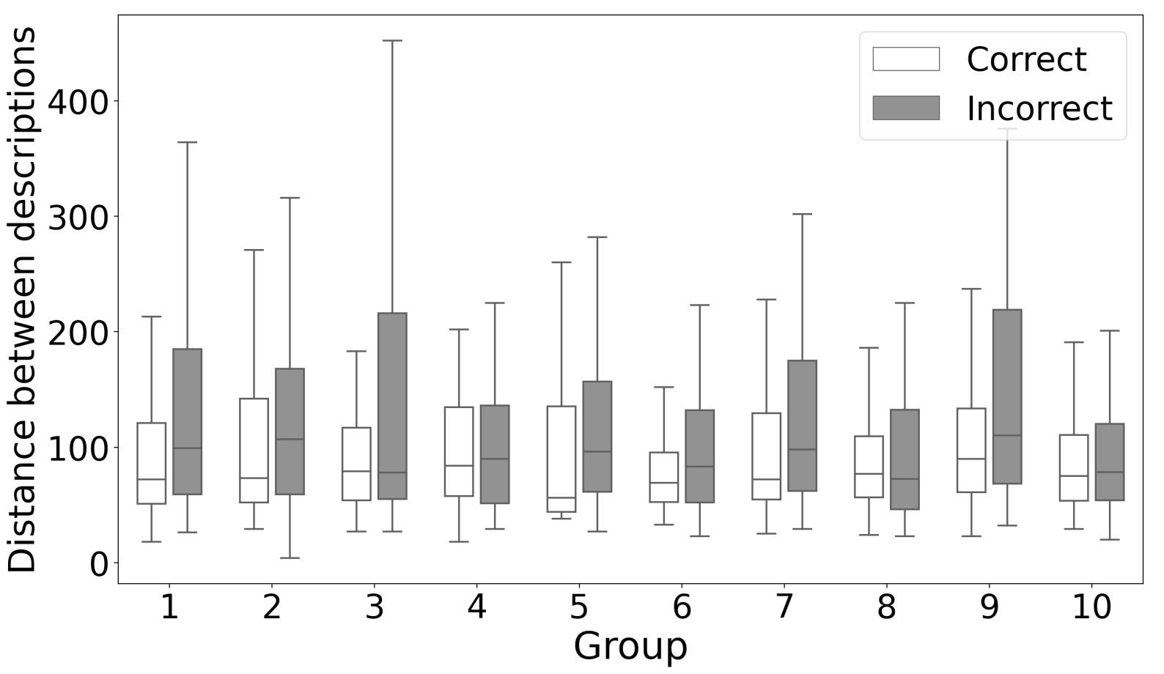
Impact of Bug Report and Patch Description
RQ-2: (1) When developer patches are paired with random bug reports, QUATRAIN is no longer able to predict over 20% of them correctly.
(2) Good patch descriptions help QUATRAIN identify more correct patches.
The distribution of probability of patch correctness on original and random bug report
The difference is statistically significant by MWW Test
Impact of distance between generated patch description to ground truth on prediction performance
Research Focus 2 - QUATRAIN

Slide 30
Methodology
Assessing Patch Correctness
How to identify the behavior of a correct patch in relation to the bug?
Research Focus 1
BATS (TOSEM’22)
Comparing the patch behavior against previously correct patches that failed on similar tests
Research Focus 2
QUATRAIN (ASE’22)
Learning the semantic correlation between the bug report and the commit message of the patch

Slide 31

Contribution and Why it matters?
Capturing the behavior of a correct patch in relation to the bug
We introduced a novel hypothesis and approach, BATS, which assesses patch correctness by identifying correct patch behavior based on similarities between failing test cases and patches.
We turned patch correctness into a question-answer problem and presented QUATRAIN, an approach that evaluates patch correctness by learning the semantic correlation between the bug report and the patch description.
Trustworthy automated program repair hinges on validating patch correctness to eliminate human guesswork and ensure safe AI-driven maintenance.

